Slide 1
CEN 3078 Computer Security
Module 3 – Defense Architectures and Design

Slide 2
Network Scanning and Vulnerability Scanning
Digital Forensics
Cybersecurity Engineering
Security policies
Firewalls
Authentication, Access controls
Federated trust
IoT/Cloud middleware
Module 3 – Defense Architectures and Design

Slide 3
Network Scanning and Vulnerability Scanning
Digital Forensics
Cybersecurity Engineering
Security policies
Firewalls
Authentication, Access controls
Federated trust
IoT/Cloud middleware
Module 3 – Defense Architectures and Design

Slide 4
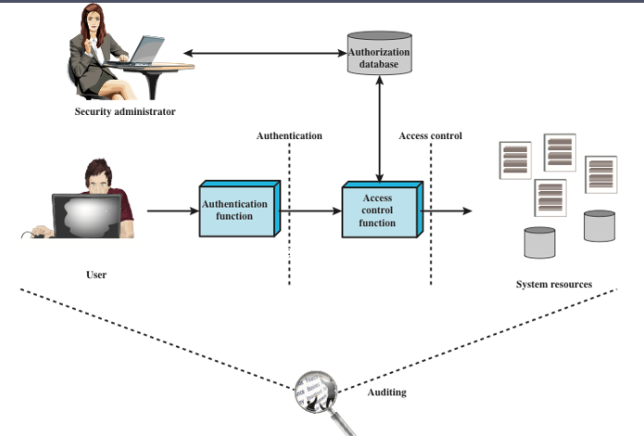
Access Control
Process by which use of system resources is regulated according to a security policy and is permitted only by authorized entities (users, programs, processes, or other systems) according to that policy
Notes:
NIST SP 800-63-3 (Digital Authentication Guideline , October 2016) defines digital
user authentication as the process of establishing confidence in user identities
that are presented electronically to an information system. Systems can use the
authenticated identity to determine if the authenticated individual is authorized
to perform particular functions, such as database transactions or access to system
resources. In many cases, the authentication and transaction, or other authorized
function, take place across an open network such as the Internet. Equally authentication
and subsequent authorization can take place locally, such as across a local
area network.

Slide 5
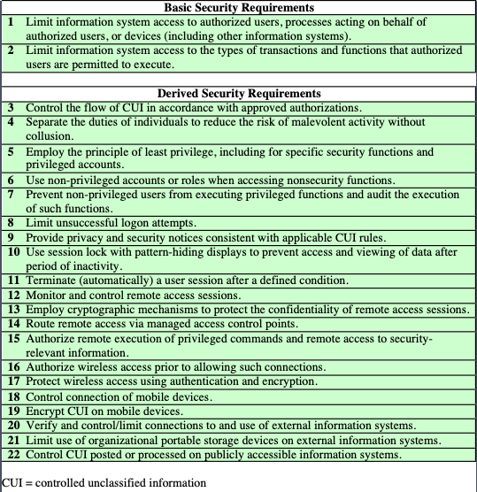
Access Control Security Requirements
Notes:
Table 4.1, from NIST SP 800-171 (Protecting Controlled Unclassified Information
in Nonfederal Information Systems and Organizations , August 2016), provides
a useful list of security requirements for access control services.

Slide 6
Access Control Policies
Discretionary access control (DAC)
Controls access based on the identity of the requestor and on access rules (authorizations) stating what requestors are (or are not) allowed to do
Mandatory access control (MAC)
Controls access based on comparing security labels with security clearances
An entity that has clearance to access a resource may not, just by its own volition, enable another entity to access that resource
Role-based access control (RBAC)
Controls access based on the roles that users have within the system and on rules stating what accesses are allowed to users in given roles
Attribute-based access control (ABAC)
Controls access based on attributes of the user, the resource to be accessed, and current environmental conditions
These four policies are not mutually exclusive; an access control mechanism can employ two or even all three of these policies to cover different classes of system resources
Notes:
An access control policy, which can be embodied in an authorization database,
dictates what types of access are permitted, under what circumstances, and by
whom. Access control policies are generally grouped into the following categories:
• Discretionary access control (DAC): Controls access based on the identity
of the requestor and on access rules (authorizations) stating what requestors
are (or are not) allowed to do. This policy is termed discretionary because an
entity might have access rights that permit the entity, by its own volition, to
enable another entity to access some resource.
• Mandatory access control (MAC): Controls access based on comparing
security labels (which indicate how sensitive or critical system resources are)
with security clearances (which indicate system entities are eligible to access
certain resources). This policy is termed mandatory because an entity that has
clearance to access a resource may not, just by its own volition, enable another
entity to access that resource.
• Role-based access control (RBAC): Controls access based on the roles that
users have within the system and on rules stating what accesses are allowed to
users in given roles.
• Attribute-based access control (ABAC): Controls access based on attributes
of the user, the resource to be accessed, and current environmental
conditions.
DAC is the traditional method of implementing access control, and is examined
in Sections 4.3 and 4.4. MAC is a concept that evolved out of requirements for
military information security and is best covered in the context of trusted systems,
which we deal with in Chapter 27. Both RBAC and ABAC have become increasingly
popular, and are examined in Sections 4.5 and 4.6, respectively.
These four policies are not mutually exclusive. An access control mechanism
can employ two or even all three of these policies to cover different classes of system
resources.

Slide 7
Subjects, Objects, and Access Rights
Subject
An entity capable of accessing objects
Three classes
Owner
Group
World
Object
A resource to which access is controlled
Entity used to contain and/or receive information
Access right
Describes the way in which a subject may access an object
Could include:
Read
Write
Execute
Delete
Create
Search
Notes:
The basic elements of access control are: subject, object, and access right.
A subject is an entity capable of accessing objects. Generally, the concept of
subject equates with that of process. Any user or application actually gains access to
an object by means of a process that represents that user or application. The process
takes on the attributes of the user, such as access rights.
A subject is typically held accountable for the actions they have initiated,
and an audit trail may be used to record the association of a subject with security relevant
actions performed on an object by the subject.
Basic access control systems typically define three classes of subject, with
different access rights for each class:
• Owner: This may be the creator of a resource, such as a file. For system resources,
ownership may belong to a system administrator. For project resources, a project
administrator or leader may be assigned ownership.
• Group: In addition to the privileges assigned to an owner, a named group of
users may also be granted access rights, such that membership in the group is
sufficient to exercise these access rights. In most schemes, a user may belong
to multiple groups.
• World: The least amount of access is granted to users who are able to access the
system but are not included in the categories owner and group for this resource.
An object is a resource to which access is controlled. In general, an object
is an entity used to contain and/or receive information. Examples include records,
blocks, pages, segments, files, portions of files, directories, directory trees, mailboxes,
messages, and programs. Some access control systems also encompass, bits,
bytes, words, processors, communication ports, clocks, and network nodes.
The number and types of objects to be protected by an access control system
depends on the environment in which access control operates and the desired tradeoff
between security on the one hand and complexity, processing burden, and ease
of use on the other hand.
An access right describes the way in which a subject may access an object.
Access rights could include the following:
• Read: User may view information in a system resource (e.g., a file, selected
records in a file, selected fields within a record, or some combination). Read
access includes the ability to copy or print.
• Write: User may add, modify, or delete data in system resource (e.g., files,
records, programs). Write access includes read access.
• Execute: User may execute specified programs.
• Delete: User may delete certain system resources, such as files or records.
• Create: User may create new files, records, or fields.
• Search: User may list the files in a directory or otherwise search the directory.

Slide 8
Discretionary Access Control (DAC)
Scheme in which an entity may be granted access rights that permit the entity, by its own violation, to enable another entity to access some resource
Often provided using an access matrix
One dimension consists of identified subjects that may attempt data access to the resources
The other dimension lists the objects that may be accessed
Each entry in the matrix indicates the access rights of a particular subject for a particular object
Notes:
As was previously stated, a discretionary access control scheme is one in which an
entity may be granted access rights that permit the entity, by its own volition, to
enable another entity to access some resource. A general approach to DAC, as
exercised by an operating system or a database management system, is that of an
access matrix. The access matrix concept was formulated by Lampson [LAMP69,
LAMP71], and subsequently refined by Graham and Denning [GRAH72, DENN71]
and by Harrison et al. [HARR76].
One dimension of the matrix consists of identified subjects that may attempt
data access to the resources. Typically, this list will consist of individual users or
user groups, although access could be controlled for terminals, network equipment,
hosts, or applications instead of or in addition to users. The other dimension lists
the objects that may be accessed. At the greatest level of detail, objects may be
individual data fields. More aggregate groupings, such as records, files, or even the
entire database, may also be objects in the matrix. Each entry in the matrix indicates
the access rights of a particular subject for a particular object.

Slide 9
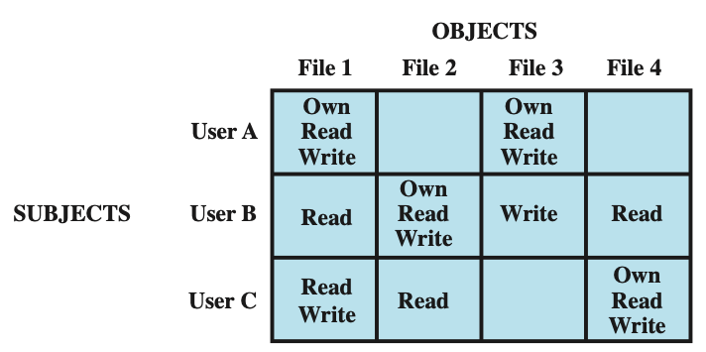
Access Control Structures Example
Access Matrix
User A owns files 1 and 3 and has read and write access rights to those
files. User B has read access rights to file 1, and so on.
Notes:
Figure 4.2a, based on a figure in [SAND94], is a simple example of an access
matrix. Thus, user A owns files 1 and 3 and has read and write access rights to those
files. User B has read access rights to file 1, and so on.

Slide 10
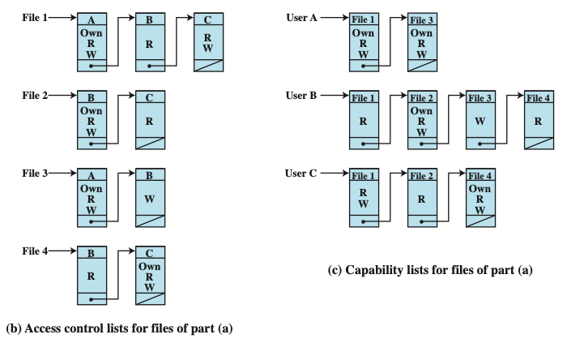
Access Control Lists
The access matrix may be decomposed by columns, yielding access control lists (ACLs)
For each object, an ACL lists users and their permitted access rights. The ACL may contain a default, or public, entry. This allows users that are not explicitly listed as having special rights to have a default set of rights. The default set of rights should always follow the rule of least privilege or read-only access, whichever is applicable. Elements of the list may include individual users as well as groups of users.
Notes:
In practice, an access matrix is usually sparse and is implemented by decomposition in one of two ways. The matrix may be decomposed by columns, yielding access control lists (ACLs); see Figure 4.2b. For each object, an ACL lists users and their permitted access rights. The ACL may contain a default, or public, entry. This allows users that are not explicitly listed as having special rights to have a default set of rights. The default set of rights should always follow the rule of least privilege or read-only access, whichever is applicable. Elements of the list may include individual users as well as groups of users.
When it is desired to determine which subjects have which access rights to a particular resource, ACLs are convenient, because each ACL provides the information for a given resource. However, this data structure is not convenient for determining the access rights available to a specific user.
Decomposition by rows yields capability tickets (Figure 4.2c). A capability
ticket specifies authorized objects and operations for a particular user. Each user
has a number of tickets and may be authorized to loan or give them to others.
Because tickets may be dispersed around the system, they present a greater
security problem than access control lists. The integrity of the ticket must be
protected, and guaranteed (usually by the operating system). In particular, the
ticket must be unforgeable. One way to accomplish this is to have the operating
system hold all tickets on behalf of users. These tickets would have to be held in
a region of memory inaccessible to users. Another alternative is to include an
unforgeable token in the capability. This could be a large random password, or a
cryptographic message authentication code. This value is verified by the relevant
resource whenever access is requested. This form of capability ticket is appropriate
for use in a distributed environment, when the security of its contents cannot
be guaranteed.
The convenient and inconvenient aspects of capability tickets are the opposite
of those for ACLs. It is easy to determine the set of access rights that a given user
has, but more difficult to determine the list of users with specific access rights for a
specific resource.

Slide 11
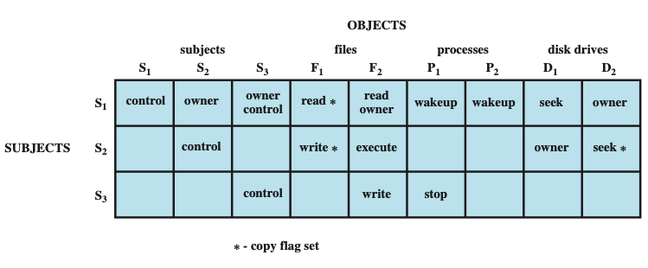
Extended Access Control Matrix
To represent the protection state, we extend the universe of objects in the access control matrix to include the following:
Processes: Access rights include the ability to delete a process, stop (block), and wake up a process
Devices: Access rights include the ability to read/write the device, to control its operation (e.g., a disk seek), and to block/unblock the device for use
Memory locations or regions: Access rights include the ability to read/write certain regions of memory that are protected such that the default is to disallow access
Subjects: Access rights with respect to a subject have to do with the ability to grantor delete access rights of that subject to other objects, as explained subsequently
Notes:
This section introduces a general model for DAC developed by Lampson, Graham,
and Denning [LAMP71, GRAH72, DENN71]. The model assumes a set of subjects,
a set of objects, and a set of rules that govern the access of subjects to objects. Let us
define the protection state of a system to be the set of information, at a given point in
time, that specifies the access rights for each subject with respect to each object. We can
identify three requirements: representing the protection state, enforcing access rights,
and allowing subjects to alter the protection state in certain ways. The model addresses
all three requirements, giving a general, logical description of a DAC system.
To represent the protection state, we extend the universe of objects in the
access control matrix to include the following:
• Processes: Access rights include the ability to delete a process, stop (block),
and wake up a process.
• Devices: Access rights include the ability to read/write the device, to control
its operation (e.g., a disk seek), and to block/unblock the device for use.
• Memory locations or regions: Access rights include the ability to read/write
certain regions of memory that are protected such that the default is to disallow
access.
• Subjects: Access rights with respect to a subject have to do with the ability to grant
or delete access rights of that subject to other objects, as explained subsequently.
Figure 4.3 is an example. For an access control matrix A, each entry A[S, X]
contains strings, called access attributes, that specify the access rights of subject S to
object X. For example, in Figure 4.3, S₁ may read file F₁, because ‘read’ appears in
A[S₁, F₁].
From a logical or functional point of view, a separate access control module is
associated with each type of object (Figure 4.4). The module evaluates each request
by a subject to access an object to determine if the access right exists. An access
attempt triggers the following steps:
1. A subject S₀ issues a request of type α for object X.
2. The request causes the system (the operating system or an access control interface
module of some sort) to generate a message of the form (S₀, α, X) to the
controller for X.
3. The controller interrogates the access matrix A to determine if α is in A[S₀, X].
If so, the access is allowed; if not, the access is denied and a protection violation
occurs. The violation should trigger a warning and appropriate action.

Slide 12
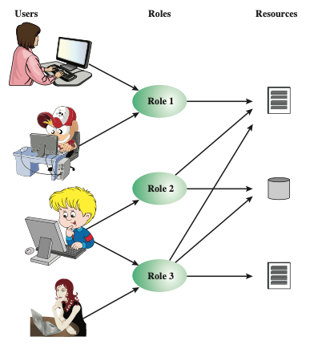
Role-Based Access Control
Traditional DAC systems define the access rights of individual users and groups of users
In contrast, RBAC is based on the roles that users assume in a system rather than the user’s identity
Typically, RBAC models define a role as a job function within an organization
RBAC systems assign access rights to roles instead of individual users
In turn, users are assigned to different roles, either statically or dynamically, according to their responsibilities
Users, Roles and Resources
Notes:
Traditional DAC systems define the access rights of individual users and groups
of users. In contrast, RBAC is based on the roles that users assume in a system
rather than the user’s identity. Typically, RBAC models define a role as a job function
within an organization. RBAC systems assign access rights to roles instead of
individual users. In turn, users are assigned to different roles, either statically or
dynamically, according to their responsibilities.
RBAC now enjoys widespread commercial use and remains an area of active
research. The National Institute of Standards and Technology (NIST) has issued a
standard, FIPS PUB 140-3, (Security Requirements for Cryptographic Modules September 2009),
that requires support for access control and administration through roles.
The relationship of users to roles is many to many, as is the relationship of
roles to resources, or system objects (Figure 4.6). The set of users changes, in some
environments frequently, and the assignment of a user to one or more roles may
also be dynamic. The set of roles in the system in most environments is relatively
static, with only occasional additions or deletions. Each role will have specific access
rights to one or more resources. The set of resources and the specific access rights
associated with a particular role are also likely to change infrequently.

Slide 13
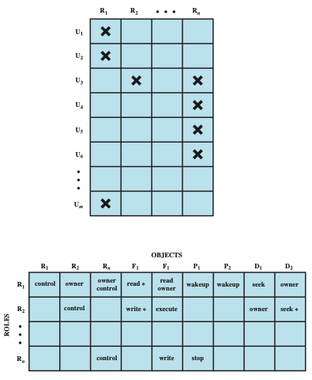
Access Control Matrix in RBAC
Notes:
We can use the access matrix representation to depict the key elements of an
RBAC system in simple terms, as shown in Figure 4.7. The upper matrix relates
individual users to roles. Typically there are many more users than roles. Each matrix
entry is either blank or marked, the latter indicating that this user is assigned to this
role. Note that a single user may be assigned multiple roles (more than one mark in a
row) and that multiple users may be assigned to a single role (more than one mark in
a column). The lower matrix has the same structure as the DAC access control matrix,
with roles as subjects. Typically, there are few roles and many objects, or resources.
In this matrix the entries are the specific access rights enjoyed by the roles. Note that a
role can be treated as an object, allowing the definition of role hierarchies.
RBAC lends itself to an effective implementation of the principle of least
privilege, referred to in Chapter 1. Each role should contain the minimum set of
access rights needed for that role. A user is assigned to a role that enables him or her
to perform only what is required for that role. Multiple users assigned to the same
role, enjoy the same minimal set of access rights.

Slide 14
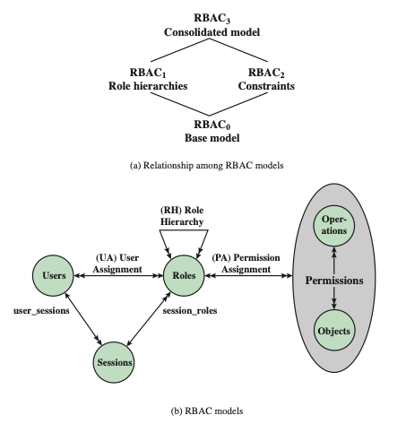
RBAC Models
Best Practice: Auth0
Notes:
A variety of functions and services can be included under the general RBAC
approach. To clarify the various aspects of RBAC, it is useful to define a set of
abstract models of RBAC functionality.
[SAND96] defines a family of reference models that has served as the basis
for ongoing standardization efforts. This family consists of four models that are
related to each other as shown in Figure 4.8a. and Table 4.4. RBAC₀ contains the
minimum functionality for an RBAC system. RBAC₁ includes the RBAC₀ functionality
and adds role hierarchies, which enable one role to inherit permissions
from another role. RBAC₂ includes RBAC₀ and adds constraints, which restrict
the ways in which the components of a RBAC system may be configured. RBAC₃
contains the functionality of RBAC₀, RBAC₁, and RBAC₂.
RBAC₀ Figure 4.8b, without the role hierarchy and constraints,
contains the four types of entities in an RBAC₀ system:
• User: An individual that has access to this computer system. Each individual
has an associated user ID.
Role: A named job function within the organization that controls this computer
system. Typically, associated with each role is a description of the authority and
responsibility conferred on this role, and on any user who assumes this role.
• Permission: An approval of a particular mode of access to one or more objects.
Equivalent terms are access right, privilege, and authorization.
• Session: A mapping between a user and an activated subset of the set of roles
to which the user is assigned.
The arrowed lines in Figure 4.8b indicate relationships, or mappings, with a
single arrowhead indicating one and a double arrowhead indicating many. Thus,
there is a many-to-many relationship between users and roles: One user may have
multiple roles, and multiple users may be assigned to a single role. Similarly, there
is a many-to-many relationship between roles and permissions. A session is used to
define a temporary one-to-many relationship between a user and one or more of the
roles to which the user has been assigned. The user establishes a session with only the
roles needed for a particular task; this is an example of the concept of least privilege.
The many-to-many relationships between users and roles and between roles
and permissions provide a flexibility and granularity of assignment not found in
conventional DAC schemes. Without this flexibility and granularity, there is a greater
risk that a user may be granted more access to resources than is needed because
of the limited control over the types of access that can be allowed. The NIST RBAC
document gives the following examples: Users may need to list directories and modify
existing files without creating new files, or they may need to append
records to a file without modifying existing records.

Slide 15
Attribute-Based Access Control
Can define authorizations that express conditions on properties of both the resource and the subject
Strength is its flexibility and expressive power
Main obstacle to its adoption in real systems has been concern about the performance impact of evaluating predicates on both resource and user properties for each access
Web services have been pioneering technologies through the introduction of the eXtensible Access Control Markup Language (XAMCL)
There is considerable interest in applying the model to cloud services
Notes:
A relatively recent development in access control technology is the attribute-based
access control (ABAC) model. An ABAC model can define authorizations that
express conditions on properties of both the resource and the subject. For example,
consider a configuration in which each resource has an attribute that identifies the
subject that created the resource. Then, a single access rule can specify the ownership
privilege for all the creators of every resource. The strength of the ABAC
approach is its flexibility and expressive power. [PLAT13] points out that the main
obstacle to its adoption in real systems has been concern about the performance
impact of evaluating predicates on both resource and user properties for each
access. However, for applications such as cooperating Web services and cloud computing,
this increased performance cost is less noticeable because there is already a
relatively high performance cost for each access. Thus, Web services have been pioneering
technologies for implementing ABAC models, especially through the introduction
of the eXtensible Access Control Markup Language (XAMCL) [BEUC13],
and there is considerable interest in applying the ABAC model to cloud services
[IQBA12, YANG12].
There are three key elements to an ABAC model: attributes, which are defined
for entities in a configuration; a policy model, which defines the ABAC policies; and
the architecture model, which applies to policies that enforce access control. We
examine these elements in turn.

Slide 16
ABAC Model Attributes
Subject attributes
A subject is an active entity that causes information to flow among objects or changes the system state
Object attributes
An object (or resource) is a passive information system-related entity containing or receiving information
Environment attributes
Describe the operational, technical, and even situational environment or context in which the information access occurs
Attributes define the identity and characteristics of the subject
Objects have attributes that can be leverages to make access control decisions
These attributes have so far been largely ignored in most access control policies
Notes:
Attributes are characteristics that define specific aspects of the subject, object, environment
conditions, and/or requested operations that are predefined and preassigned
by an authority. Attributes contain information that indicates the class of information
given by the attribute, a name, and a value (e.g., Class=HospitalRecordsAccess,
Name=PatientInformationAccess, Value=MFBusinessHoursOnly).
The following are the three types of attributes in the ABAC model:
• Subject attributes: A subject is an active entity (e.g., a user, an application, a
process, or a device) that causes information to flow among objects or changes
the system state. Each subject has associated attributes that define the identity
and characteristics of the subject. Such attributes may include the subject’s
identifier, name, organization, job title, and so on. A subject’s role can also be
viewed as an attribute.
• Object attributes: An object, also referred to as a resource , is a passive (in the
context of the given request) information system-related entity (e.g., devices,
files, records, tables, processes, programs, networks, domains) containing or
receiving information. As with subjects, objects have attributes that can be
leveraged to make access control decisions. A Microsoft Word document, for
example, may have attributes such as title, subject, date, and author. Object
attributes can often be extracted from the metadata of the object. In particular,
a variety of Web service metadata attributes may be relevant for access
control purposes, such as ownership, service taxonomy, or even Quality of
Service (QoS) attributes.
• Environment attributes: These attributes have so far been largely ignored in
most access control policies. They describe the operational, technical, and even
situational environment or context in which the information access occurs. For
example, attributes, such as current date and time, the current virus/hacker
activities, and the network’s security level (e.g., Internet vs. intranet), are not
associated with a particular subject nor a resource, but may nonetheless be
relevant in applying an access control policy.

Slide 17
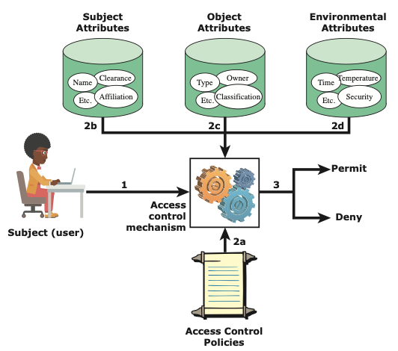
ABAC Scenario
It is clear from the logical architecture that there are four independent sources of information used for the access control decision. The system designer can decide which attributes are important for access control with respect to subjects, objects, and environmental conditions. The system designer or other authority can then define access control policies, in the form of rules, for any desired combination of attributes of subject, object, and environmental conditions.
Notes:
Figure 4.10 illustrates in a logical architecture the essential components of an ABAC
system. An access by a subject to an object proceeds according to the following steps:
1. A subject requests access to an object. This request is routed to an access control
mechanism.
2. The access control mechanism is governed by a set of rules (2a) that are defined
by a preconfigured access control policy. Based on these rules, the access control
mechanism assesses the attributes of the subject (2b), object (2c), and current
environmental conditions (2d) to determine authorization.
3. The access control mechanism grants the subject access to the object if access
is authorized and denies access if it is not authorized.
It is clear from the logical architecture that there are four independent sources
of information used for the access control decision. The system designer can decide
which attributes are important for access control with respect to subjects, objects,
and environmental conditions. The system designer or other authority can then
define access control policies, in the form of rules, for any desired combination of
attributes of subject, object, and environmental conditions. It should be evident that
this approach is very powerful and flexible. However, the cost, both in terms of
the complexity of the design and implementation and in terms of the performance
impact, is likely to exceed that of other access control approaches. This is a tradeoff
that the system authority must make.

Slide 18
ABAC Distinguishable Characteristics
Distinguishable because it controls access to objects by evaluating rules against the attributes of entities, operations, and the environment relevant to a request
Relies upon the evaluation of attributes of the subject, attributes of the object, and a formal relationship or access control rule defining the allowable operations for subject-object attribute combinations in a given environment
Systems are capable of enforcing DAC, RBAC, and MAC concepts
Allows an unlimited number of attributes to be combined to satisfy any access control rule
Apply ABAC if
You’re in a large organization with many users
You want deep, specific access control capabilities
You have time to invest in a model that goes the distance
You need to ensure privacy and security compliance
Notes:
ABAC is a logical access control model that is distinguishable because it controls
access to objects by evaluating rules against the attributes of entities (subject
and object), operations, and the environment relevant to a request. ABAC relies
upon the evaluation of attributes of the subject, attributes of the object, and a formal
relationship or access control rule defining the allowable operations for subject-object
attribute combinations in a given environment. All ABAC solutions contain
these basic core capabilities to evaluate attributes and enforce rules or relationships
between those attributes. ABAC systems are capable of enforcing DAC, RBAC,
and MAC concepts. ABAC enables fine-grained access control, which allows for a
higher number of discrete inputs into an access control decision, providing a bigger
set of possible combinations of those variables to reflect a larger and more definitive
set of possible rules, policies, or restrictions on access. Thus, ABAC allows an
unlimited number of attributes to be combined to satisfy any access control rule.
Moreover, ABAC systems can be implemented to satisfy a wide array of requirements
from basic access control lists through advanced expressive policy models
that fully leverage the flexibility of ABAC.

Slide 19
Enterprise-wide Access Control
Resource management
Concerned with defining rules for a resource that requires access control
Rules would include credential requirements and what user attributes, resource attributes, and environmental conditions are required for access of a given resource for a given function
Privilege management
Concerned with establishing and maintaining the entitlement or privilege attributes that comprise an individual’s access profile
These attributes represent features of an individual that can be used as the basis for determining access decisions to both physical and logical resources
Privileges are considered attributes that can be linked to a digital identity
Policy management
Governs what is allowable and unallowable in an access transaction
Notes:
Three support elements
are needed for an enterprise-wide access control facility:
• Resource management: This element is concerned with defining rules for
a resource that requires access control. The rules would include credential
requirements and what user attributes, resource attributes, and environmental
conditions are required for access of a given resource for a given
function.
• Privilege management: This element is concerned with establishing and maintaining
the entitlement or privilege attributes that comprise an individual’s
access profile. These attributes represent features of an individual that can be
used as the basis for determining access decisions to both physical and logical
resources. Privileges are considered attributes that can be linked to a digital
identity.
• Policy management: This element governs what is allowable and unallowable
in an access transaction. That is, given the identity and attributes of
the requestor, the attributes of the resource or object, and environmental
conditions, a policy specifies what actions this user can perform on this
object.

Slide 20
Network Scanning and Vulnerability Scanning
Digital Forensics
Cybersecurity Engineering
Security policies
Firewalls
Authentication, Access controls
Federated trust
IoT/Cloud middleware
Module 3 – Defense Architectures and Design

Slide 21
Identity Federation
Term used to describe the technology, standards, policies, and processes that allow an organization to trust digital identities, identity attributes, and credentials created and issued by another organization
Addresses two questions:
How do you trust identities of individuals from external organizations who need access to your systems
How do you vouch for identities of individuals in your organization when they need to collaborate with external organizations
Notes:
Identity federation addresses two questions:
1. How do you trust identities of individuals from external organizations who
need access to your systems?
2. How do you vouch for identities of individuals in your organization when they
need to collaborate with external organizations?

Slide 22
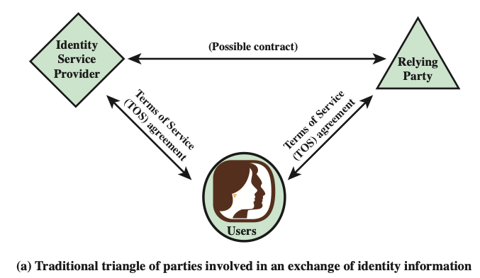
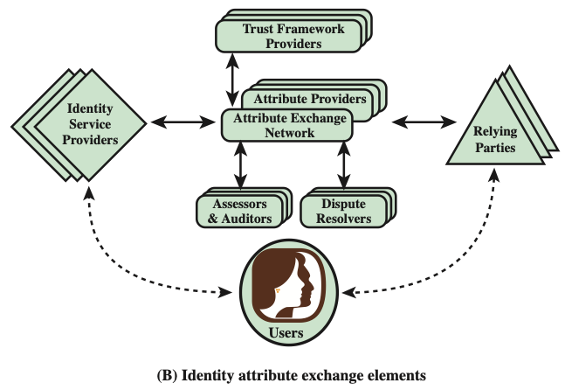
Identity Information Exchange Approaches
OpenID
An open standard that allows users to be authenticated by certain cooperating sites using a third-party service
Notes:
Online or network transactions involving parties from different organizations, or
between an organization and an individual user such as an online customer, generally
require the sharing of identity information. This information may include a host
of associated attributes in addition to a simple name or numerical identifier. Both
the party disclosing the information and the party receiving the information need
to have a level of trust about security and privacy issues related to that information.
Figure 4.13a shows the traditional technique for the exchange of identity information.
This involves users developing arrangements with an identity service provider
to procure digital identity and credentials, and arrangements with parties that
provide end-user services and applications and that are willing to rely on the identity
and credential information generated by the identity service provider.
The arrangement of Figure 4.13a must meet a number of requirements. The
relying party requires that the user has been authenticated to some degree of assurance,
that the attributes imputed to the user by the identity service provider are
accurate, and that the identity service provider is authoritative for those attributes.
The identity service provider requires assurance that it has accurate information
about the user and that, if it shares information, the relying party will use it in
accordance with contractual terms and conditions and the law. The user requires
assurance that the identity service provider and relying party can be entrusted with
sensitive information and that they will abide by the user’s preferences and respect
the user’s privacy. Most importantly, all the parties want to know if the practices
described by the other parties are actually those implemented by the parties, and
how reliable those parties are.
Without some universal standard and framework, the arrangement of Figure 4.13a
must be replicated in multiple contexts. A far preferable approach is to develop an
open, standardized approach to trustworthy identity and attribute exchange. In the
remainder of this section, we examine such an approach that is gaining increasing
acceptance.
Unfortunately, this topic is burdened with numerous acronyms, so it is best to
begin with a definition of the most important of these:
• OpenID: This is an open standard that allows users to be authenticated by certain
cooperating sites (known as Relying Parties) using a third party service,
eliminating the need for Webmasters to provide their own ad hoc systems and
allowing users to consolidate their digital identities. Users may create accounts
with their preferred OpenID identity providers, and then use those accounts as
the basis for signing on to any website which accepts OpenID authentication.
Figure 4.13b shows the elements involved in the OITF. Within any given organization
or agency, the following roles are part of the overall framework:
• Relying parties (RPs): Also called service providers, these are entities delivering
services to specific users. RPs must have confidence in the identities and/or
attributes of their intended users, and must rely upon the various credentials
presented to evince those attributes and identities.
• Subjects: These are users of an RP’s services, including customers, employees,
trading partners, and subscribers.
• Attribute providers (APs): APs are entities acknowledged by the community
of interest as being able to verify given attributes as presented by subjects
and which are equipped through the AXN to create conformant attribute credentials
according to the rules and agreements of the AXN. Some APs will
be sources of authority for certain information; more commonly APs will be
brokers of derived attributes.
• Identity providers (IDPs): These are entities able to authenticate user credentials
and to vouch for the names (or pseudonyms or handles) of subjects, and
which are equipped through the AXN or some other compatible Identity and
Access Management (IDAM) system to create digital identities that may be
used to index user attributes.
There are also the following important support elements as part on an AXN:
• Assessors: Assessors evaluate identity service providers and RPs and certify
that they are capable of following the OITF provider’s blueprint.
• Auditors: These entities may be called on to check that parties’ practices have
been in line with what was agreed for the OITF.
• Dispute resolvers: These entities provide arbitration and dispute resolution
under OIX guidelines.
• Trust framework providers: A trust framework provider is an organization
that translates the requirements of policymakers into an own blueprint for a
trust framework that it then proceeds to build, doing so in a way that is consistent
with the minimum requirements set out in the OITF specification. In
almost all cases, there will be a reasonably obvious candidate organization to
take on this role, for each industry sector or large organization that decides it
is appropriate to interoperate with an AXN.
The solid arrowed lines in Figure 4.13b indicate agreements with the trust
framework provider for implementing technical, operations, and legal requirements.
The dashed arrowed lines indicate other agreements potentially affected
by these requirements. In general terms, the model illustrated in Figure 4.13b
would operate in the following way. Responsible persons within participating
organizations determine the technical, operational, and legal requirements for
exchanges of identity information that fall under their authority. They then select
OITF providers to implement these requirements. These OITF providers translate
the requirements into a blueprint for a trust framework that may include additional
conditions of the OITF provider. The OITF provider vets identity service
providers and RPs and contracts with them to follow its trust framework requirements
when conducting exchanges of identity information. The contracts carry
provisions relating to dispute resolvers and auditors for contract interpretation
and enforcement.

Slide 23
OAuth 2.0 Intro.
OAuth 2 is an authorization framework that enables applications — such as Facebook, GitHub, and DigitalOcean — to obtain limited access to user accounts on an HTTP service.
It works by delegating user authentication to the service that hosts a user account and authorizing third-party applications to access that user account.
OAuth 2 provides authorization flows for web and desktop applications, as well as mobile devices.

Slide 24
OAuth Roles
OAuth defines four roles:
Resource Owner: The resource owner is the user who authorizes an application to access their account. The application’s access to the user’s account is limited to the scope of the authorization granted (e.g. read or write access)
Client: The client is the application that wants to access the user’s account. Before it may do so, it must be authorized by the user, and the authorization must be validated by the API.
Resource Server: The resource server hosts the protected user accounts.
Authorization Server: The authorization server verifies the identity of the user then issues access tokens to the application.

Slide 25
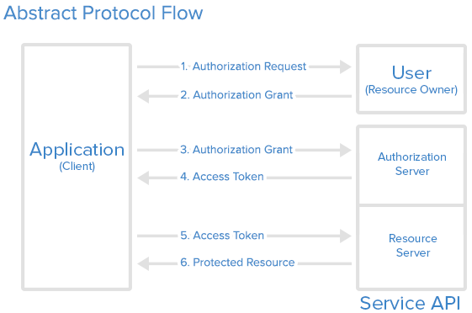
OAuth Steps

Slide 26
OAuth service steps
Application Registration
Application Name
Application Website
Redirect URI or Callback URL
Authorization Grant – Various Types
Authorization Code: used with server-side Applications
Client Credentials: used with Applications that have API access
Device Code: used for devices that lack browsers or have input limitations

Slide 27
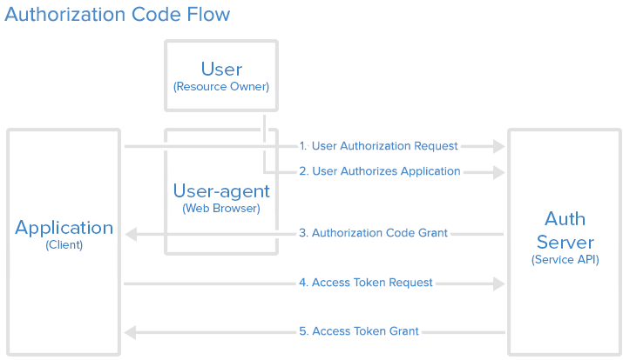
Most used Grant Type: Authorization Code

Slide 28
Network Scanning and Vulnerability Scanning
Digital Forensics
Cybersecurity Engineering
Security policies
Firewalls
Authentication, Access controls
Federated trust
IoT/Cloud middleware
Module 3 – Defense Architectures and Design

Slide 29
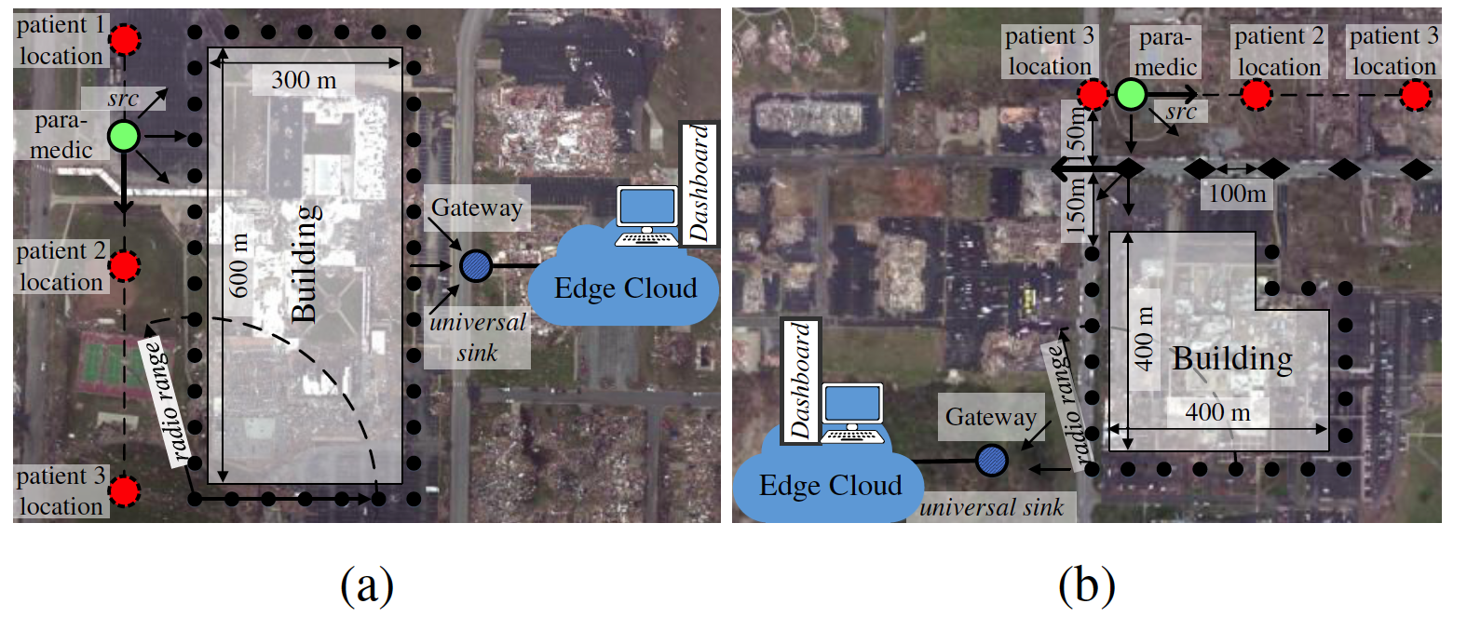
Lightweight and Flexible Security for IoT-based Smart City Applications
Recreated disaster scenes of tornado damages (in Joplin, MO 2011) at the: (a) Joplin High School; (b) Joplin Hospital

Slide 30
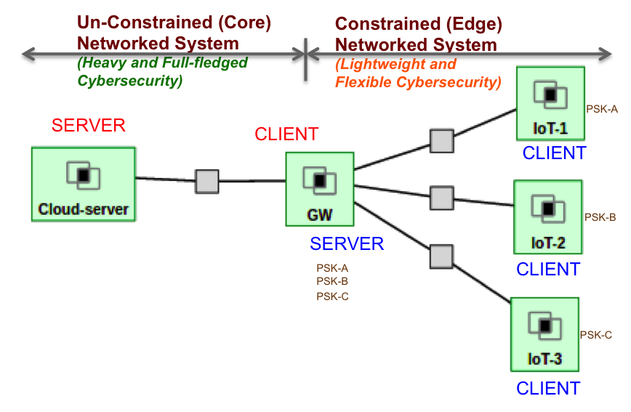
Lightweight and Flexible Security for IoT-based Smart City Applications
IoT Gateway Middleware that uses machine learning to decide on tradeoffs in energy, latency and security in deciding computing policies at core or edge
B. Mukherjee, S. Wang, W. Lu, R. Neupane, D. Dunn, Y. Ren, Q. Su, P. Calyam, “Flexible IoT Security Middleware for End-to-End Cloud-Fog Communication”, Elsevier Future Generation Computer Systems (FGCS) – Special Issue on Internet of Things (IoT): Operating System, Applications and Protocols Design, and Validation Techniques, 2018.

Slide 31
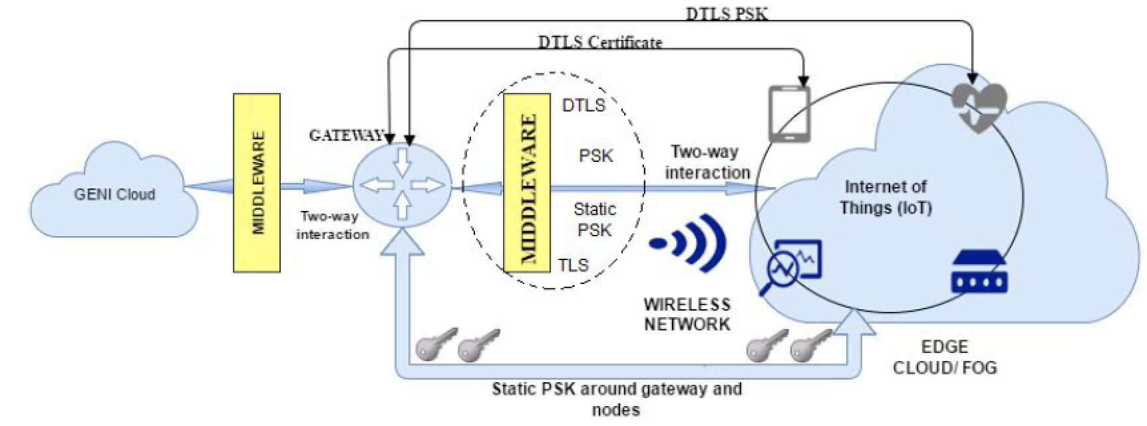
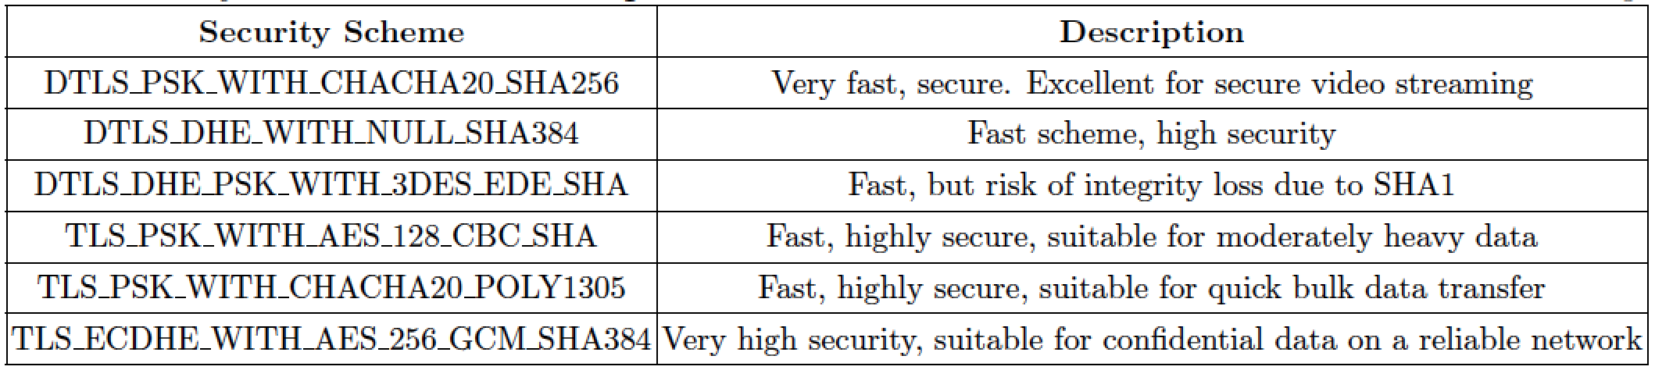
Resource-aware IoT Security Middleware for End-to-End Cloud-Fog Communication
Gateway-hosted middleware stores and tracks sessions, certificates or keys between the fog and cloud entities
Decouples services and protocols for end-to-end security using static pre-shared keys for quick encryption setup
Selection of security protocols to be used based on resource-awareness

